Slide 1
Welcome to “Trade, Technical, Career Running Start”
This session, scheduled for 7-8 PM, will be recorded.
Mics will be muted. Please type your questions in chat.
Your IH PTSA hosts this evening:
Tracie Kinsley of the IH PTSA College and Career Committee
Kim Wilkinson, our IH PTSA Co-President
www.issaquahhighptsa.org
@IssaquahHighPTSA
@IHPTSA
Email: ihptsaCCP@gmail.com

Slide 2
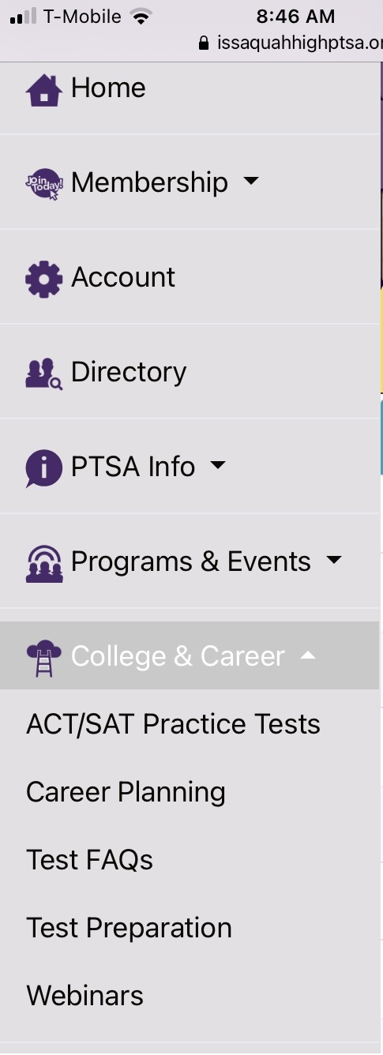
College and Career Planning Webinars Page
Issaquahhighptsa.org
College and Career-> Webinars
Recorded Webinars and Useful Links
Essay Writing
Paying for College
Resumes and Interviews
Starting a Business/Non-Profit
Tonight’s presentation and suggested links will be added here

Slide 3
Tonight we have a panel featuring:
An Chu, Running Start Coordinator
www.lwtech.edu/academics/high-school/runningstart
Email: running.start@lwtech.edu
Chelsea Paulsen, Interim Academic & Career Counselor
www.rtc.edu/running-start
Email: Chelsea Good, Running Start Faculty Counselor, cgood@rtc.edu
Anastasia Whitaker, Running Start New Student Liaison
www.bellevuecollege.edu/runningstart
Email: runningstartnewstudent@bellevuecollege.edu

Slide 4
Agenda
Panel Questions – Information unique to each school
General Information - Applicable to all the schools
Audience Questions

Slide 5
What Are Your Most Popular Programs?

Slide 6
Please describe available certifications and degrees for Running Start Students

Slide 7
Are internships or other opportunities available to get work experience while in your program?

Slide 8
What are the costs to attend?

Slide 9
What are the job opportunities for graduates? How does the school help with job placement?

Slide 10
For students that choose to seek a Bachelors Degree, please discuss your program’s preparation and support

Slide 11
General Info: Classes
How Do Classes Differ From High School Classes?
Classes are taken for a quarter basis (vs. semester or year-long)
Students may be in classes for only 2-3 hours a day (vs. being at school for 6+ hours a day)
Classes may be online asynchronous
Most work is completed outside of the classroom
Students will be in classes with community members from a variety of ages and backgrounds
There is no attendance office. There is no parent view of grades.
Parents are not contacted regarding attendance or grades.

Slide 12
General Info: Part or Full Time
Both are options, depending on the student’s goals and courses already taken.
To earn an Associate’s Degree, full-time is required junior and senior year.
Not all schools offer courses to meet all H.S. graduation requirements.
Ex: RTC does NOT offer PE courses.

Slide 13
General Info: Admissions
There is no GPA requirement to apply
There may be a small application fee
Paperwork is required, such as an Application, Running Start Agreement, and Enrollment Verification Form
The High School transcript is sent by the local high school counselor
English and Math Placement are based on the transcript, Placement Tests, or Directed Self-Placement, depending on the transcript and Running Start Program
Issaquah High School Information:
https://sites.google.com/site/ishscounseling/RST
Information Session Feb 8 during NEST for IHS students
Attend an information session being run by the college you would like to attend for more details on Admissions

Slide 14
Audience Questions

Slide 15
For More Information
An Chu, Running Start Coordinator
www.lwtech.edu/academics/high-school/runningstart
Email: running.start@lwtech.edu
Chelsea Paulsen, Interim Academic & Career Counselor
www.rtc.edu/running-start
Email: Chelsea Good, Running Start Faculty Counselor, cgood@rtc.edu
Anastasia Whitaker, Running Start New Student Liaison
www.bellevuecollege.edu/runningstart
Email: runningstartnewstudent@bellevuecollege.edu
https://sites.google.com/site/ishscounseling/RST

